Slide 1
Microbiology Dep.
Second year
Parasitology
14th Lec.
Lecturer: Assist prof.
Dr.Sally Ahmed
Phylum Acanthocephala
(thorny/spiny-headed worms)
The phylum Acanthocephala includes more than 1000 species of relatively small vermiform endoparasites. The adults of which feed on the intestinal walls of vertebrates, especially in freshwater and marine fishes. Very few cases of human infection by these worms have been reported.
Several species from this phylum have been reported to cause human infection including Moniliformis moniliformis, Macracanthorhynchus hirudinaceus, Macracanthorhynchus ingens, Acanthocephalus bufonis, A. rauschi, and Corynosoma strumosum.
Morphology
By having no gut and being parasitic in the vertebrate intestine, the acanthocephalans resemble cestodes, but morphologically they are totally different. Diagnostically, the adult acanthocephalans have spiny retractable proboscis for attachment. The sexes are separated. The body is divided into two regions, the anterior part or praesoma, which includes the proboscis and neck and the main trunk or metasoma. The proboscis is invaginable and can be withdrawn into a muscular sheath/sac (proboscis receptacle). The number, arrangement and shape of the proboscis hooks serve to distinguish one species from another. Trunk spines embedded in the metasomal body wall, aid in gripping the gut wall and may assist locomotion.

Slide 2
Life cycle
Although the complete life cycles are known for only about 25 species of acanthocephalans, all species seem to follow the same basic pattern. The adult acanthocephalans occur in the intestine of the final host. Eggs are evacuated in feces and after being ingested by the suitable intermediate host; they hatch and develop through a number of stages in the arthropod midgut. The acanthor, the first larval stage, is provided with hooklets that are used for boring through the gut wall into the hemocoel where the acanthor develops into a second-stage larva, the acanthella, which gradually acquires a proboscis and rudiments of other structures of the mature worm. The final immature stage in the arthropod host is the cystacanth, in which the rudiments of structures become recognizable as those of the adult worm. On ingestion of the infected arthropod, the appropriate vertebrate host acquires the infection and the worm develops to maturity and mates and begins to lay eggs.

Slide 3
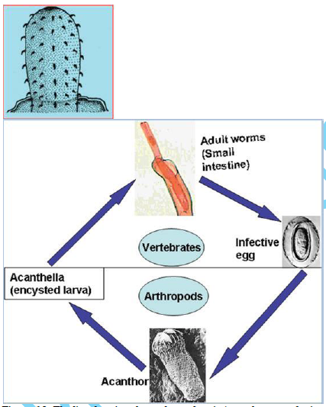

Slide 4
Diagnosis
The diagnosis depends mainly on identifying adult worms or eggs in the feces. The presence of an armed, retractable proboscis, and the absence of the digestive tract, true coelom, and circulatory system, distinguish intact adult acanthocephalans from other helminthes.
Symptoms
Infections with Moniliformis moniliformis, for example, are accompanied with some manifestations which varied from asymptomatic passage of worms, to loss of appetite, weight loss, severe abdominal pain, diarrhoea, fever, general malaise, vomiting, and irritability.
Control
Control measures include avoiding handling insects and other arthropods that may serve as intermediate hosts for these worms and avoiding eating uncooked white meats.

Slide 5
Phylum: Annelida
(segmented worms)
Only a few species of annelids are commonly known to human beings, these include the earthworms that make the soils healthy, the famous medicinal leeches which are still used in many countries for various medicinal uses, and marine polychaetes.
Class Hirundinea
This Class contains about 500 species of animals commonly known as leeches. Leeches are well known for their blood sucking habits. Except
for the primitive Acanthobdella peledina, leeches have no chaetae and 33-34 body segments. They have two suckers which in most cases are located one at the anterior (head) end of the body composed of segments 1-4 and the other at the posterior (tail) end composed of segments 25-33. Like the Oligochaeta from which they are believed to have evolved, Hirundinea occur in fresh water, marine and terrestrial environments.

Slide 6
Medicinal leech (Hirudo medicinalis)
Medicinal leech (Hirudo medicinalis) belongs to the Phylum Annelida, Class Hirudinida, Order Gnathobdelida, Family Hirudinidae, and Genus Hirudo.
Morphology
Leeches have segmented bodies like an earthworm. The body is divided into 33 or 34 segments. Externally, medicinal leeches tend to have a brown and red striped design on an olive colored background. They all have an anterior (oral) sucker and a posterior (anal or caudal) sucker formed from the last seven segments of their body. The oral sucker contains the mouth and is used to connect to a host for feeding. They use a combination of mucus and suction (caused by concentric muscles in the sucker) to stay attached. Medicinal leeches have three jaws that look like little saws, and on them are about 100 sharp teeth used to incise the host. The leech also has five pairs of eyes. The leeches can grow up to 20 cm in length

Slide 7
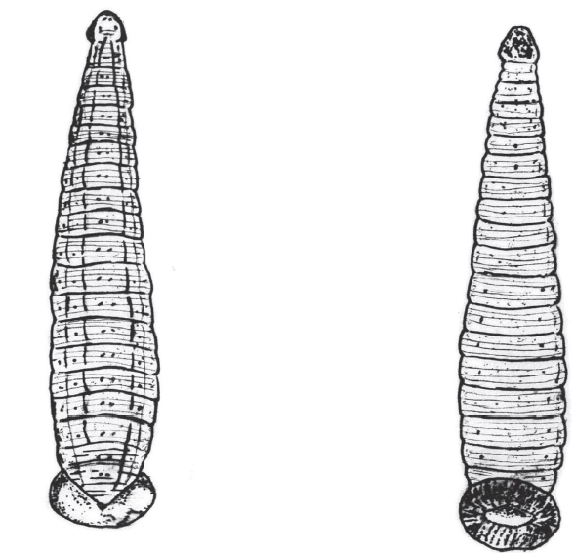
General morphology of the medicinal leech (Hirudo medicinalis).

Slide 8
Biology and habitat
The leech is an amphibious freshwater animal, and usually found in small pools with muddy bottoms. Leeches feed on blood. Having attached itself to the host animal, it pierces the skin and injects an anaesthetic to hide the pain of its bite so that the host does not find the leech and remove it, and an anticoagulant chemical, which prevents the host’s blood from clotting whilst the leech feeds. The length of time a leech may feed seems to vary. During a meal, it may extract 15 millilitres of blood, which can increase the size of the leech by anything up to eleven times its normal body dimensions. A leech’s meal can sustain it for over six months. Leeches find their host animals by detecting disturbance in the water, and they can prey on small creatures as well as large. A frog or a newt, for example, can die from excessive blood-loss following an attack by a leech. Leeches are often found in the nests of birds and seem to use them as shelter as well as finding a food source.

Slide 9
Life cycle
Leeches are true hermaphrodites, having both male and female parts, but they still need to come together to mate with each other. After mating, 15-50 eggs are laid in a spongy case or cocoon, above the waterline often under stones. The eggs hatch in three to five weeks and the young leeches need two seasons of feeding before they are ready to breed.
Use of Hirudo medicinalis in medicine
However, medicinal leeches have been used for removing ‘bad blood’ from human patients for hundreds of years. Leech saliva contains several compounds including a hyaluronidase (increases the permeability of the host skin), a histamine-like compound or vasodilator (dilates the blood vessels), an anticoagulant (prevents blood clots or breaks apart clots) and possibly ananesthetic. In addition, the leech saliva contains a peptide called hirudin, which is a highly effective anticoagulant. The leech needs this to prevent blood clots (which would block its feeding) from forming in the wound created by its mouthparts. These properties are difficult to achieve using other medical techniques, and it is for this reason that leeches have come back into clinical practice in the last 25 years. The small amounts of hirudin present in leeches makes it unsuitable to be harvested for more general medical use, so hirudin (or related chemicals) have been synthesised using recombinant-DNA technology.

Slide 10
Phylum: Arthropoda
Class Arachnida:
This class includes spiders, scorpions, ticks and mites. The last two groups are important. All ticks are parasitic and often vectors of diseases. Although most mites are free-living, some are important parasites. Characteristically, the adult stage has four pairs of legs and wings are absent.
Class Arachnida
Scabies mites (Order Acarina) Scabies mites is an eight-legged minute arthropds with round body. The mouthparts broadly resemble those of ticks with various modifications to suit different feeding habits. Scabies mite (Sarcoptes scabiei) (Figure 8-10) is distributed worldwide. Scabies is common in poor communities with inadequate washing facilities. The mite transmitted by contact, burrows intothe skin between fingers, later spreading to the wrists, elbows and the rest of the body.

Slide 11
Scabies mite. Female (top) and male (bottom) mites. The diagram shows a Life cycle

